Slide 1
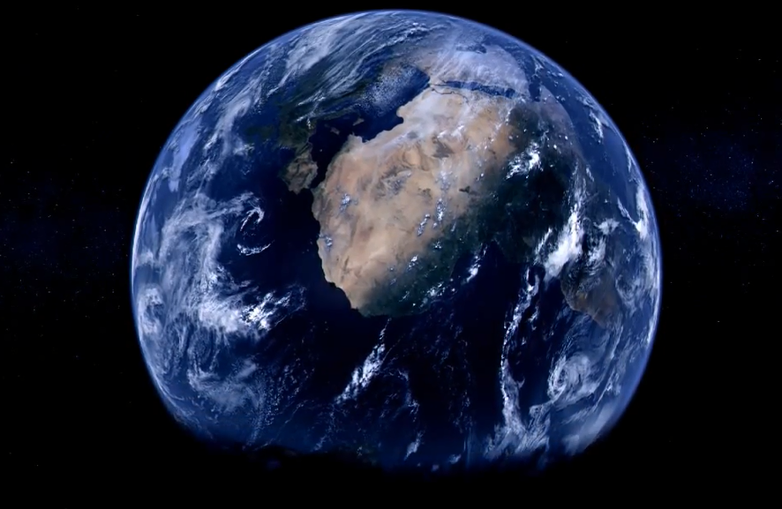
Home. «el cambio está en nosotros»

Slide 2
Awetrfyguhujkrjiohibb HjjjjHJGHGJGJgjG

Slide 3
Awetrfyguhujkrjiohibb drthiijko ggfggfudd hhkhf

Slide 4
Awetrfyguhujkrjiohibb drthiijko ggfggfudd hhkhf

Slide 5
Awetrfyguhujkrjiohibb drthiijko ggfggfudd hhkhf

Slide 6
Awetrfyguhujkrjiohibb drthiijko ggfggfudd hhkhf

Slide 7
Awetrfyguhujkrjiohibb drthiijko ggfggfudd hhkhf

Slide 8
Awetrfyguhujkrjiohibb drthiijko ggfggfudd hhkhf

Slide 9
Awetrfyguhujkrjiohibb drthiijko ggfggfudd hhkhf

Slide 10
Awetrfyguhujkrjiohibb drthiijko ggfggfudd hhkhf

